Slide 1
Hexadecimal
Mack 2021

Slide 2
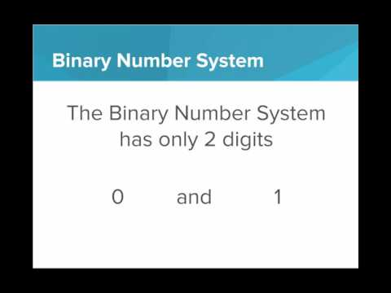
We learn about one more number system: Hexadecimal, or Base 16.

Slide 3
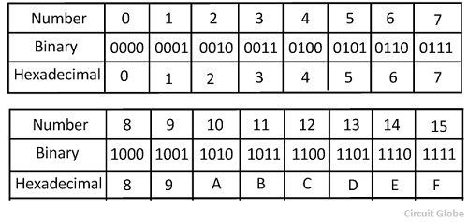
What is the value of 9F16 in binary?
Notes:
🍐 This is a Pear Deck Multiple Choice Slide. Your current options are: A: 1001 1111, B: 1111 1001, C: 0111 1000, D: 1100 0011,
🍐 To edit the type of question or choices, go back to the "Ask Students a Question" in the Pear Deck sidebar.
A

Slide 4
What is the value of C₁₆ in decimal?
16₁₀
12₁₀
6₁₀
13₁₀
Notes:
🍐 This is a Pear Deck Multiple Choice Slide. Your current options are: A: A, B: B, C: C, D: D,
🍐 To edit the type of question or choices, go back to the "Ask Students a Question" in the Pear Deck sidebar.

Slide 5
Practice: Binary to Hex Game
This exercise is a visual game to practice making hexadecimal numbers from bits. Clicking on each bit toggles the value from a 0 to a 1, or vice versa.
The hexadecimal target value is shown in the bottom of the window. Flip the bits of the binary number until you successfully create the binary value that represents the given hexadecimal value.
Try to get at least 100 points, then answer these questions with a partner.
DISCUSSION QUESTIONS
Are there any hexadecimal digits that cannot be created using 4 bits?
How many bits would you need to represent the hexadecimal value 1016?
If you wanted to be able to represent every hexadecimal value from 016 to FF16, how many bits would you need?
Describe how you would go about converting 1001 0011 1101 10102 into hexadecimal. What is this value in hexadecimal?

